Slide 1
AGILE METHODOLOGIES
References:
R.S. Pressman & Associates, Inc. Software Engineering: A Practitioner’s Approach, 6/e .copyright © 1996, 2001, 2005.

Slide 2
Questions & discussion?
Can anyone determine all requirements of the system at the beginning of the software development process?
What should we do if the requirements change at the later stage?

Slide 3
Agile
An adaptive software development process was introduced in a paper by Edmonds (1974)
Notable early Agile methods include Scrum (1986),
Crystal Clear, Extreme Programming (1996)
Adaptive Software Development, Feature Driven Development, and Dynamic Systems Development Method (DSDM) (1995)
These are typically referred to as Agile Methodologies since the Agile Manifesto was published in 2001.
In 2001, prominent members of the community met at Snowbird, Utah, and adopted the name "agile methods”

Slide 4
What is Agile?
The approach of Practitioners.
A set of methodologies which base on basic principles to delivery the product
quickly, reliably
Meet with user’s requirements

Slide 5
Manifesto for Agile Software Development
We are uncovering better ways of developing software by doing it and helping others do it.
Individuals and interactions over processes and tools
Working software over comprehensive documentation
Customer collaboration over contract negotiation
Responding to change over following a plan

Slide 6
Principles behind the Agile Manifesto
Our highest priority is to satisfy the customer through early and continuous delivery of valuable software.
Welcome changing requirements, even late in development. Agile processes harness change for the customer's competitive advantage.

Slide 7
Principles behind the Agile Manifesto
Deliver working software frequently, from a couple of weeks to a couple of months, with a preference to the shorter timescale.
Business people and developers must work together daily throughout the project.

Slide 8
Principles behind the Agile Manifesto
Business people and developers must work together daily throughout the project.
Build projects around motivated individuals. Give them the environment and support they need, and trust them to get the job done.
The most efficient and effective method of conveying information to and within a development team is face-to-face conversation.

Slide 9
Principles behind the Agile Manifesto
Working software is the primary measure of progress.
Agile processes promote sustainable development. The sponsors, developers, and users should be able to maintain a constant pace indefinitely.
Continuous attention to technical excellence and good design enhances agility.

Slide 10
Principles behind the Agile Manifesto
Simplicity--the art of maximizing the amount of work not done--is essential.
The best architectures, requirements, and designs emerge from self-organizing teams.
At regular intervals, the team reflects on how to become more effective, then tunes and adjusts its behavior accordingly.

Slide 11
Agile Processes
Extreme Programming
ASD (Adaptive Software Development)
DSDM (Dynamic Systems Development Method)
Scrum
Crystal
Feature Driven Development
Agile Modeling

Slide 12
Iteration
is “heartbeat” of Agile development.
Can delivery tested/checked codes in a short time/period
A Period for one Iteration: 2 weeks?
The period of one iteration: should be fixed during the process.
For long Iterations, team can built a water-fall process for each Iteration.
XP suggest 1 – 4 weeks/iteration
Scrum suggest 30 days/Sprint(iteration)
RUP suggest 2 – 6 weeks/iteration

Slide 13
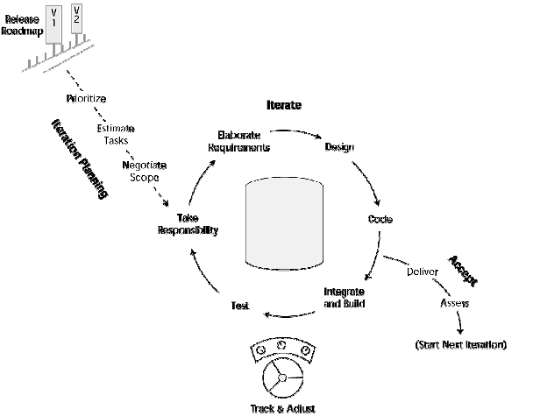
Iteration

Slide 14
Iteration
Iteration planning
Iteration Execution
Deliver & accept

Slide 15
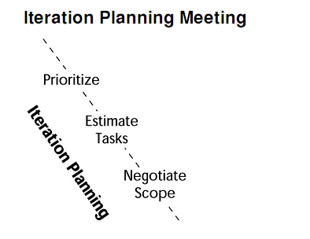
Iteration Planning
Consider choose the priority for each item in the back-blog.
Define and estimate essential tasks to deliver.
Discuss, deal and negotiate the scope of selected tasks.
All team members should have responsibility for Iteration planning
Iteration planning: < 1 day
Agile team leader/Scrum Master; product owner/business analyst; developer; test, QA, and documentation personnel; and architect.

Slide 16
Iteration Planning
The Product Owner’s responsibility | The Development team’s responsibility
Review and approve Iteration planning. | Review the high priority items in backblog and prepare questions.
Review items in back-blog to re-assign the priority in case. | Consider technical issues, constraints, dependencies, … and share with the team.
Understand the need of clients, the business value of each iteration. | Think about tasks to do estimate in the meeting.
Prepare carefully the details of requirements. | …
…

Slide 17
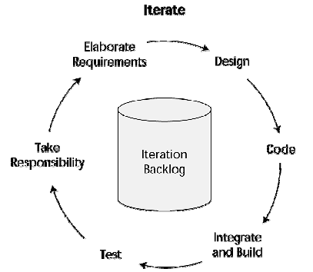
Iteration Execution
Iteration cycle will be repeated until finishing all backblog items.

Slide 18
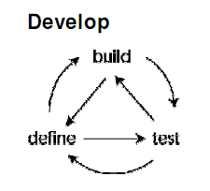
Iteration Execution
Each developer or the pair of developers:
Take “responsibility” for each backblog item.
Develop each backblog item (design, code, integrate, and test).
Delivery and Integrate backblog item into the system
Notify that the backblog item have been finished and ready for testing.

Slide 19

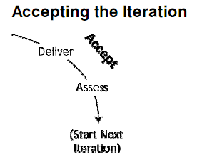
Accepting Iteration
Meeting to accept the Iteration
Present the result
Discuss and get the feedbacks from the customers
Product owners decide the accepted status for tasks what have been done and what is the remain or next tasks for next Iteration.

Slide 20
Daily stand-ups
Have the meeting at the same time every day; the team decides when this should be.
Have the meeting in the same location every day; this avoids the frustration of having to secure a room, find the room, and communicate room shifts to team members.
Make sure everyone stands up; sitting promotes problem solving, discussions that should be held after the stand-up.
Limit the meeting to a 15-minute time box; stick to 1 to 2 minutes per report.
Start on time; late-comers can adversely affect your ability to keep the meeting to 15 minutes.
Participants should include all members of the development team: the folks who have their hands on the keyboards and the folks who understand the details behind the user stories

Slide 21
Daily stand-ups
What I did yesterday
What I am doing today.
What is getting in my way? (Am I blocked?)

Slide 22
Extreme Programming - XP
The most widely used agile process, originally proposed by Kent Beck
XP Planning
Begins with the creation of “user stories” (Features & Functionalities)
Agile team assesses each story and assigns a cost
Stories are grouped to for a deliverable increment
A commitment is made on delivery date
Order the stories (all, riskiest, highest value)
After the first increment “project velocity” is used to help define subsequent delivery dates for other increments

Slide 23
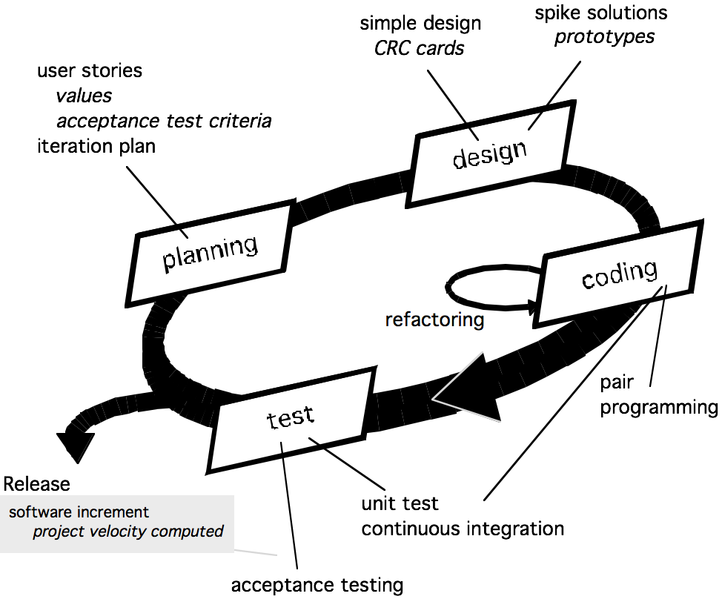
Extreme Programming - XP

Slide 24
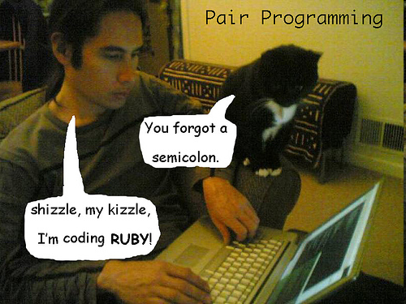

Pair programming

Slide 25
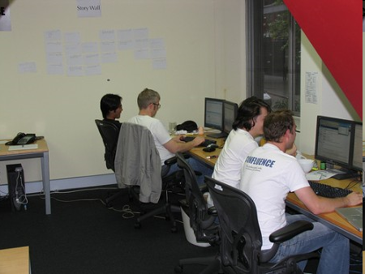
Pair programming

Slide 26
Scrum Process
"Pig" roles: Pigs are the ones committed to the project and the Scrum process
Product Owner
ScrumMaster
Team: A small team of 5-9 people with cross-functional skills to do the actual work (designer, developer etc.).
"Chicken" roles
ideas, needs, desires
planning of each sprint
Review, feedback
Users
Stakeholders (Customers, Vendors)
Managers: people that will set up the environment for the product development organizations.

Slide 27
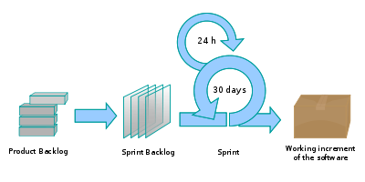
Scrum Process
Schwaber & Beedle: 1986

Slide 28
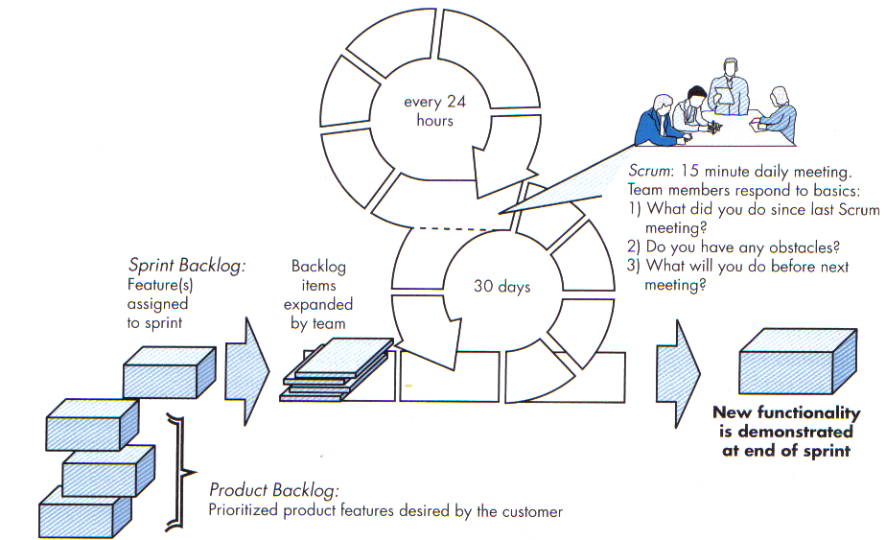
Scrum Process

Slide 29


